Slide 1
Stock market prediction using sentiment and time series analysis
Group :- 2

Slide 2
contents – 1) Sentiment analysis 2) Time Series 3) Integration of sentiment analysis and stock price in our project 4) Conclusion

Slide 3
Sentiment Analysis
Sentiment analysis is contextual mining of text which identifies and extracts subjective information in source material and helping a business to understand the social sentiment of their brand, product or service while monitoring online conversations.

Slide 4

WHAT ???

Slide 5

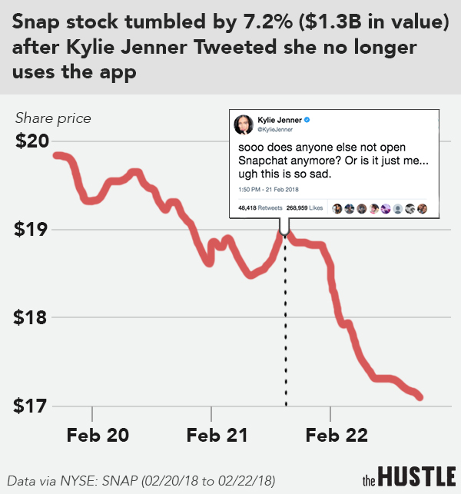
Kylie’s Tweet

Slide 6
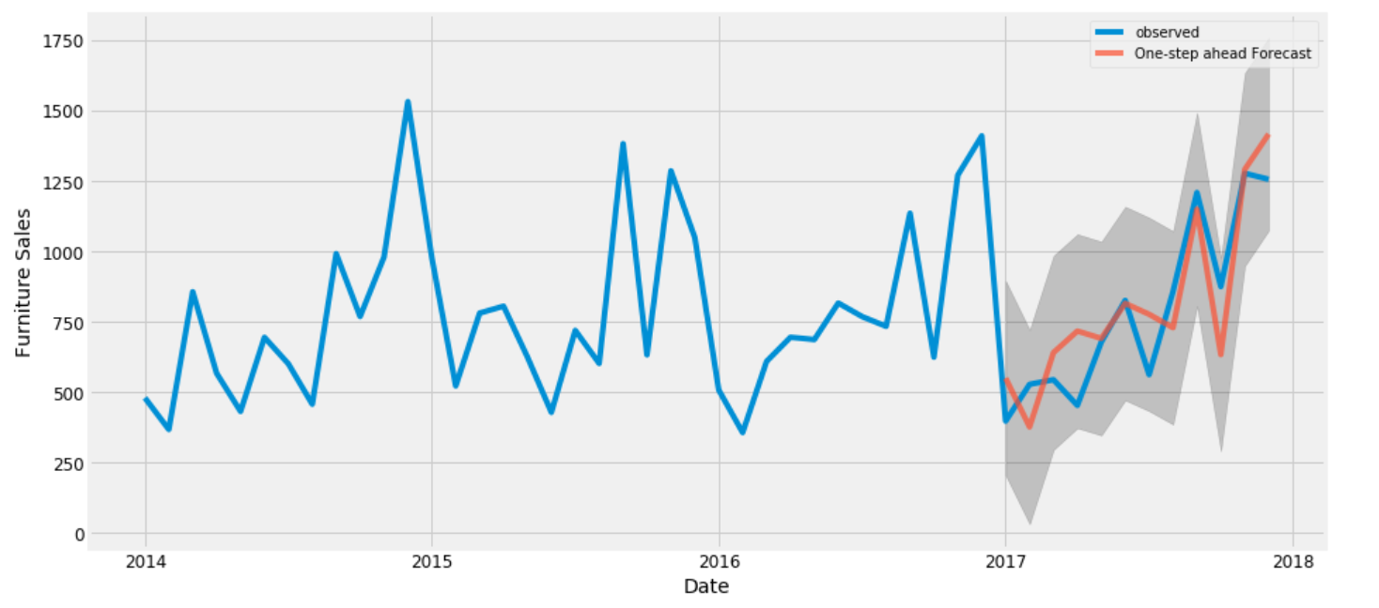
Time Series Analysis
When and Why?
Time series analysis helps organizations understand the underlying causes of trends or systemic patterns over time.
Time series analysis is used for non-stationary data—things that are constantly fluctuating over time or are affected by time.

Slide 7

Long story short -

Slide 8

The Model (Tesla)
Building a word cloud for the most common used words for the keyword “Tesla” on twitted feed.
Data – Tweets of user and
News headlines

Slide 9
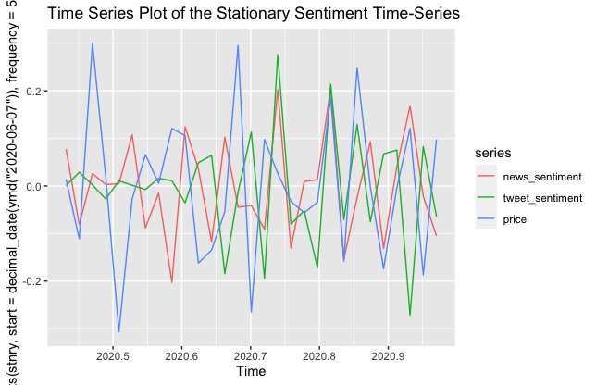
Graphing the sentiment score on a time series plot w.r.t the price

Slide 10
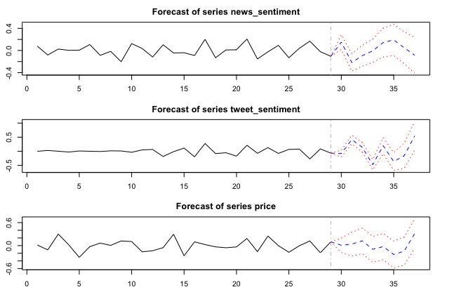
Forecasting the features

Slide 11
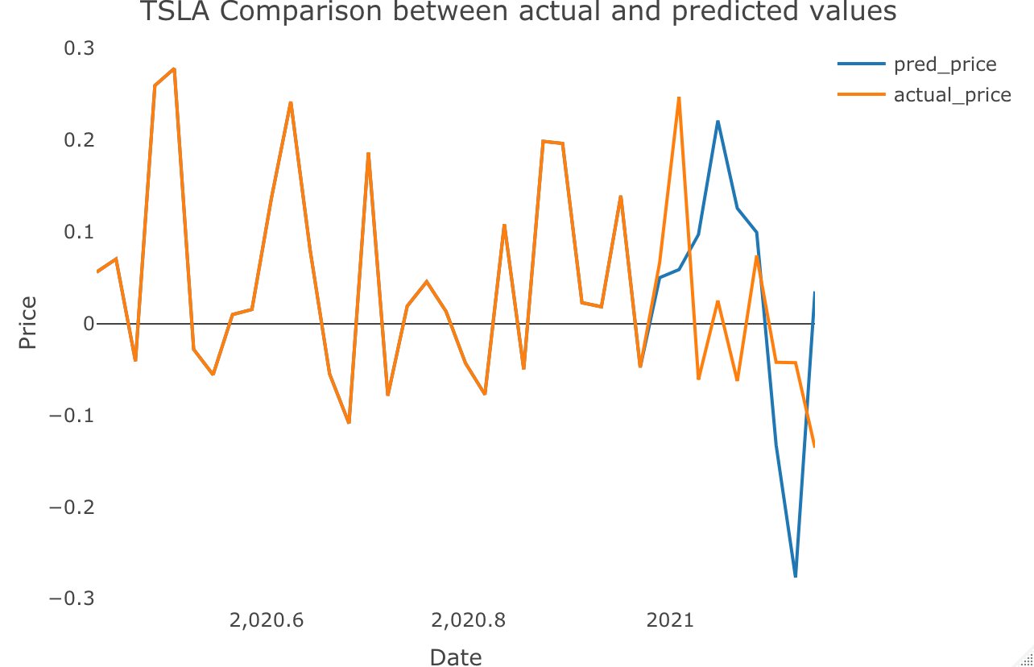
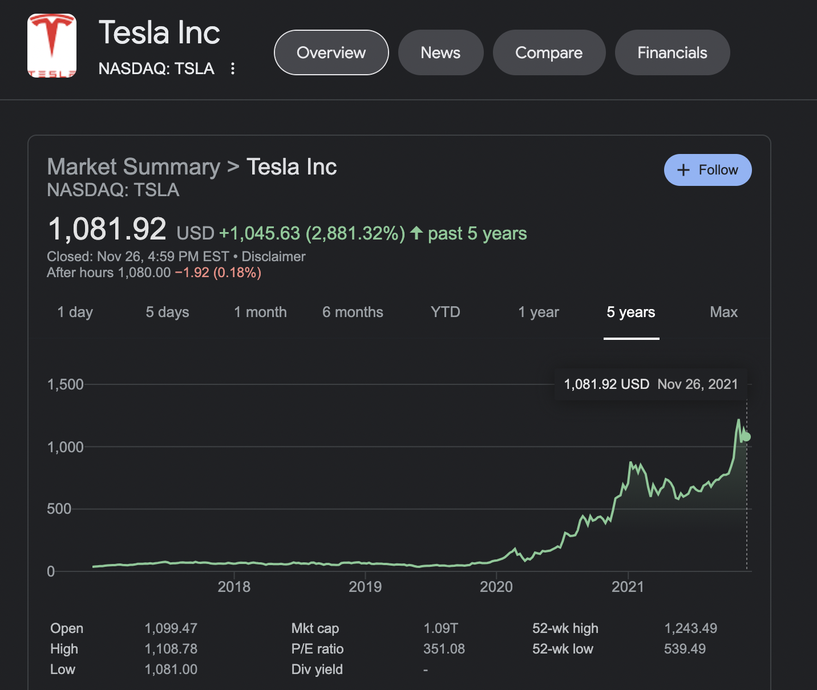
Comparison
Our model
Live Tesla stock price

Slide 12
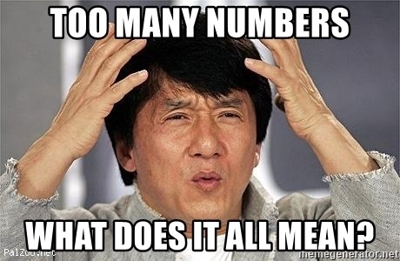

Slide 13
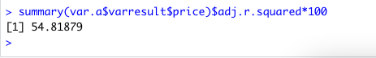
Evaluation of the Tesla Model
R-Squared Value – 54.81

Slide 14
moderna

Slide 15

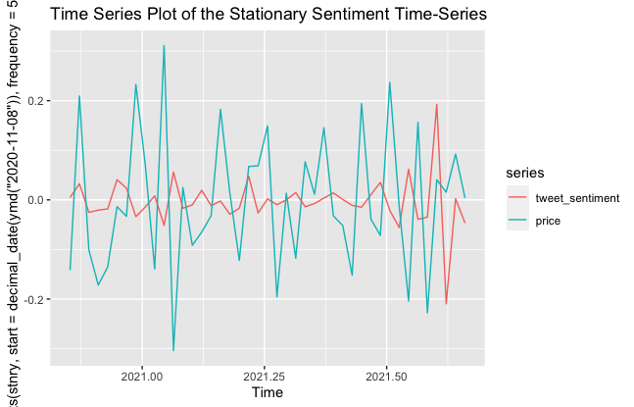
Analysis and Forecasting for “Moderna”
Moderna (most common words in tweets and news)
Word Cloud
Time series plot of sentiment score vs relative stock price (Moderna)

Slide 16
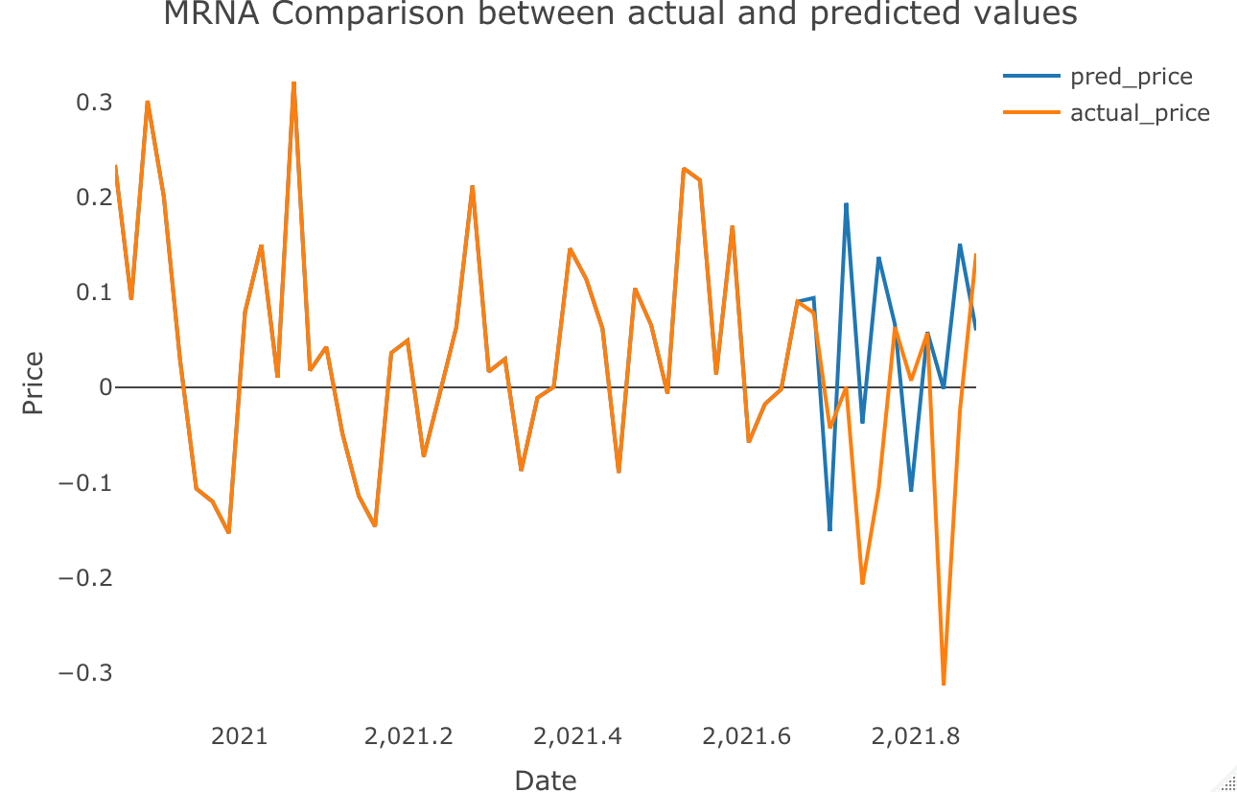
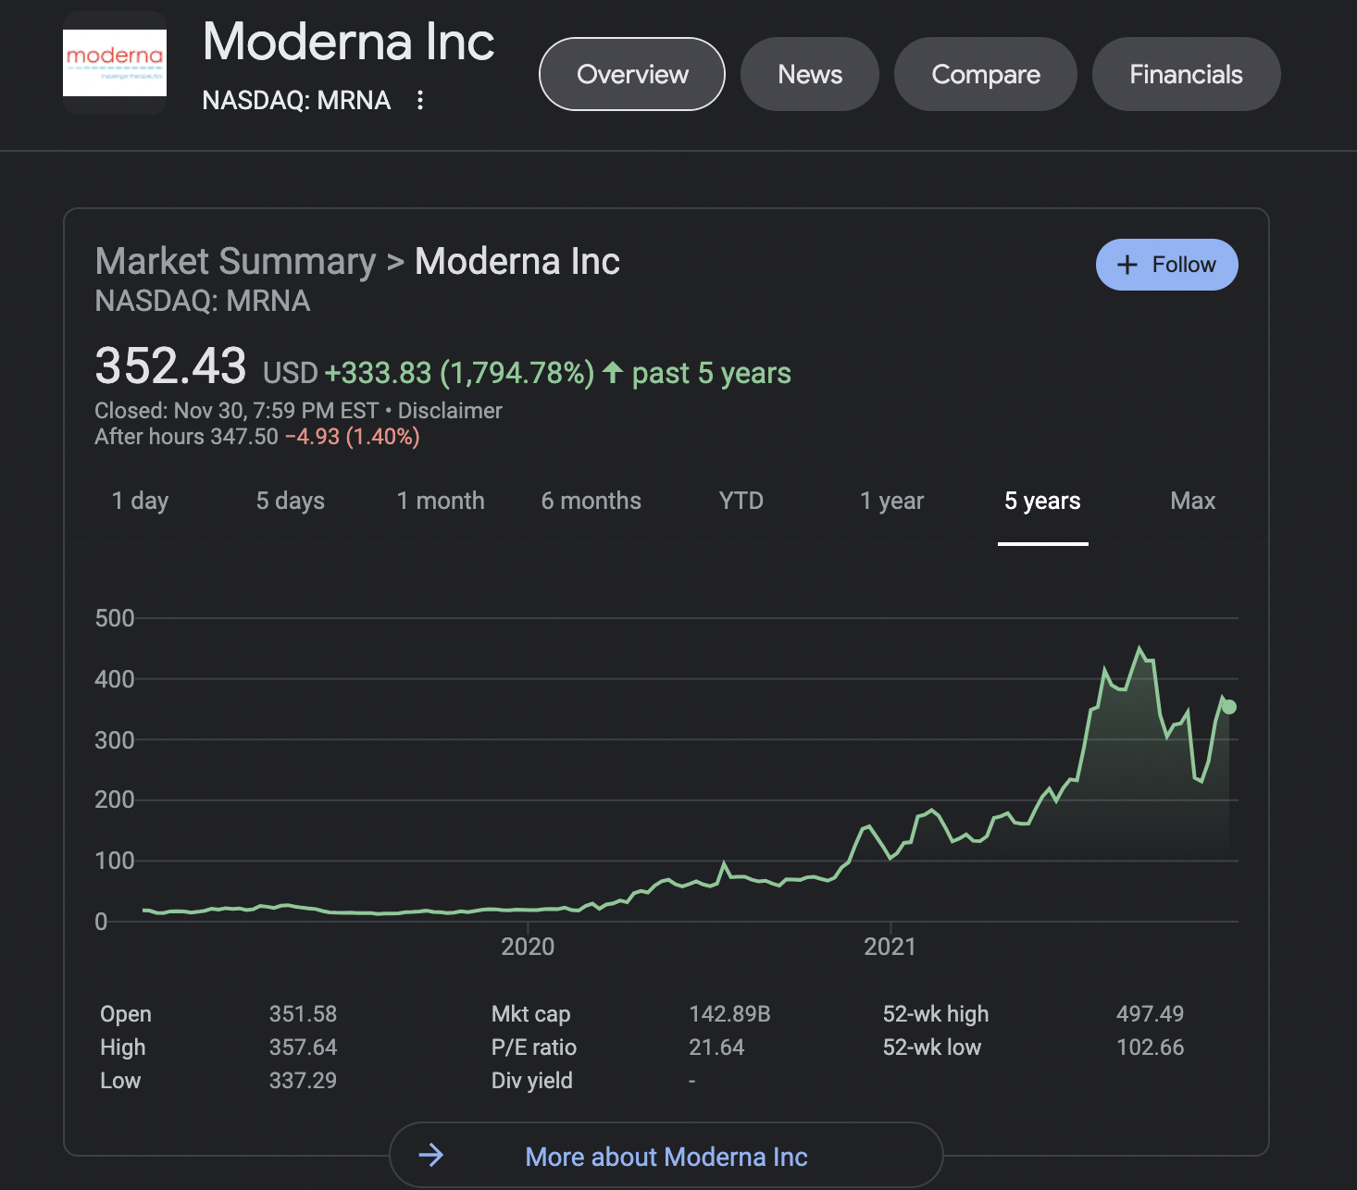
Comparison
Our model
Live Moderna Stock Price

Slide 17
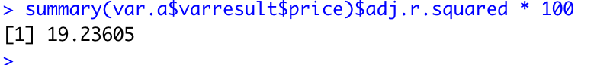
Evaluation of the Moderna Model
R-Squared Value – 19.23

Slide 18


Slide 19
Conclusion
Scopes of Improvement –
Scrape data off News Articles and not just the headlines.
Do not totally rely on sentiment score as often words (tweets/news) could be misleading.
Increase the time metric for the time series analysis.
Not everybody refer to tweets and read headlines to invest in a particular stock.
Stock price gets affected to various other factors too.

